Slide 1
Apartheid
in South Africa
Nelson Mandela & F.W. de Klerk
© 2014 Brain Wrinkles

Slide 2
Standards
SS7H1 The student will analyze continuity and change in Africa leading to the 21st century.
c. Explain the creation and end of apartheid in South Africa and the roles of Nelson Mandela and F.W. de Klerk.
© 2014 Brain Wrinkles

Slide 3
Apartheid
In 1948, the National Party, came to power and voted to implement a series of restrictive segregationist laws, known collectively as apartheid.
The National Party enforced the policy of apartheid through a series of laws.
Apartheid was a social and political policy of racial segregation and discrimination.
In Afrikaans (the language of white South Africans), apartheid means “apartness”.
© 2014 Brain Wrinkles

Slide 4
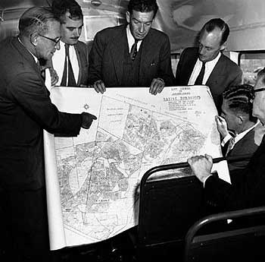
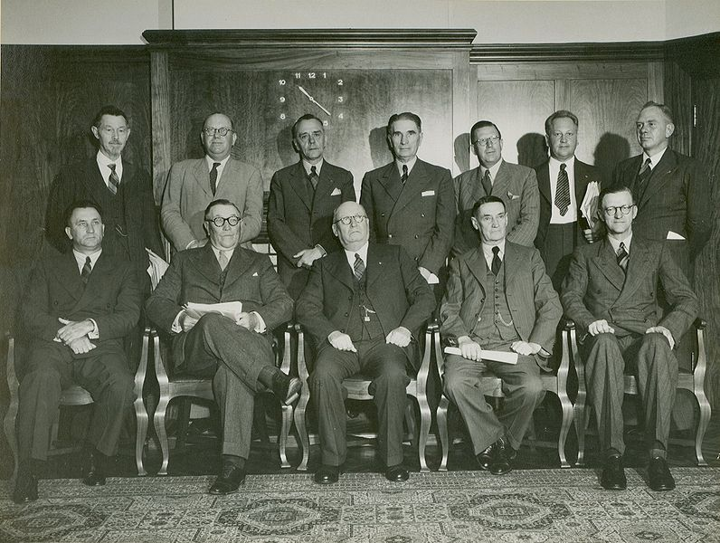
National Party, 1948
© 2014 Brain Wrinkles

Slide 5
Segregation
It separated South Africa into whites and non-whites, restricting where blacks could live, work, travel, sit, go to the bathroom, eat, etc.
Under apartheid, blacks could not vote or participate in government.
What does this remind you of??
In 1951, government officials passed the Bantu Authorities Act
Placed all non-white population in “homelands”
Whites owned 80% of the land, although they only represented 10% of the population.
9 million South Africans were excluded from participating in the government

Slide 6
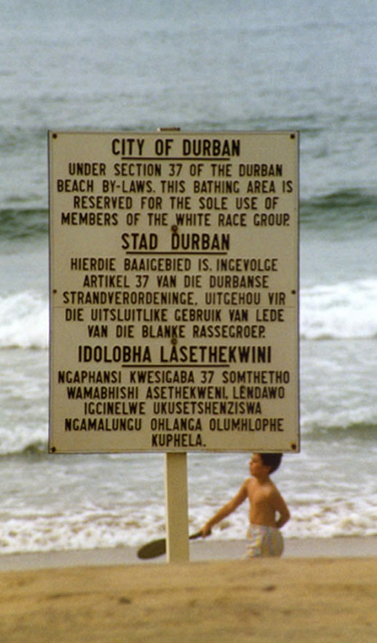
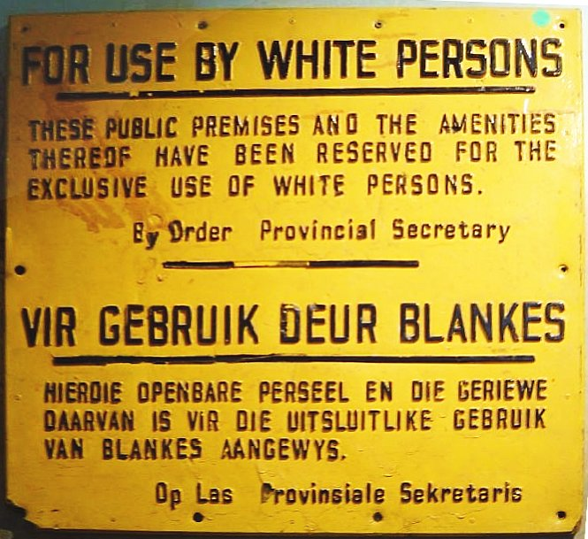
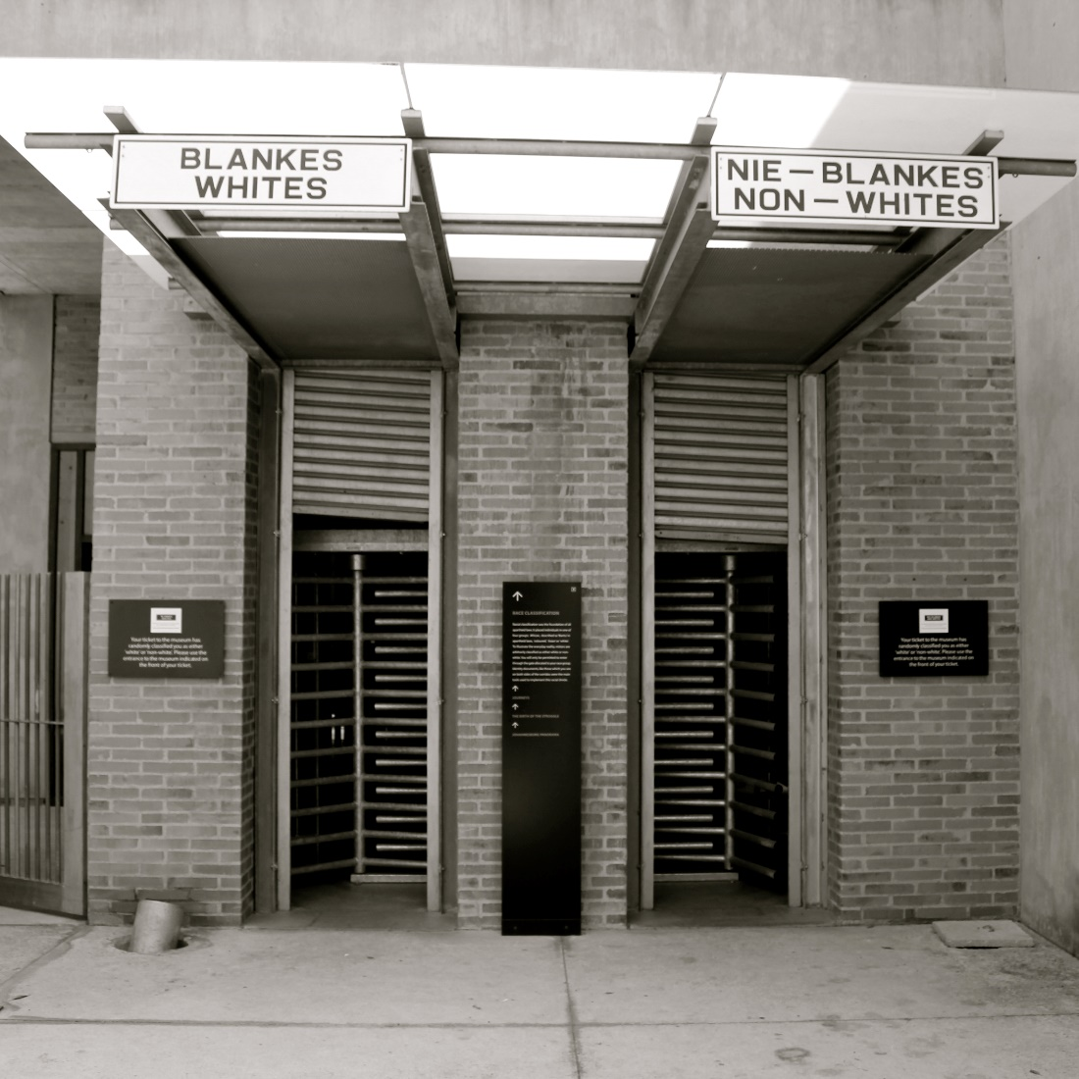
© 2014 Brain Wrinkles

Slide 7
Life Under Apartheid
Apartheid allowed many whites to grow wealthy and powerful, while millions of blacks suffered.
Afrikaners (white population) lived in up-scale neighborhoods
Native South Africans lived in slums or in Bantustans.
Bantustans were the “homelands” for native Africans to live on.
Bantustans offered a poor quality of land and were unfit for the large populations forced to live there.
South Africans were unable to leave their Bantustan without a passport.
© 2014 Brain Wrinkles

Slide 8
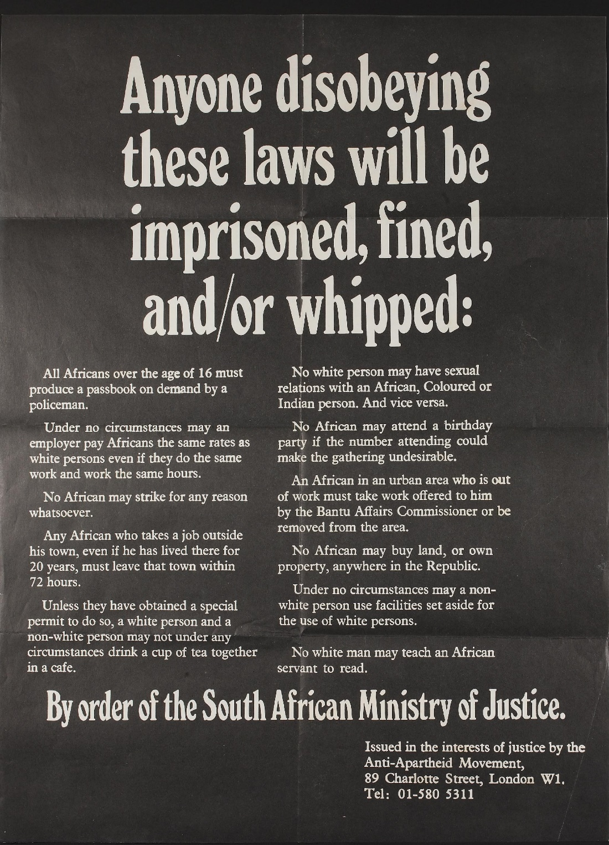
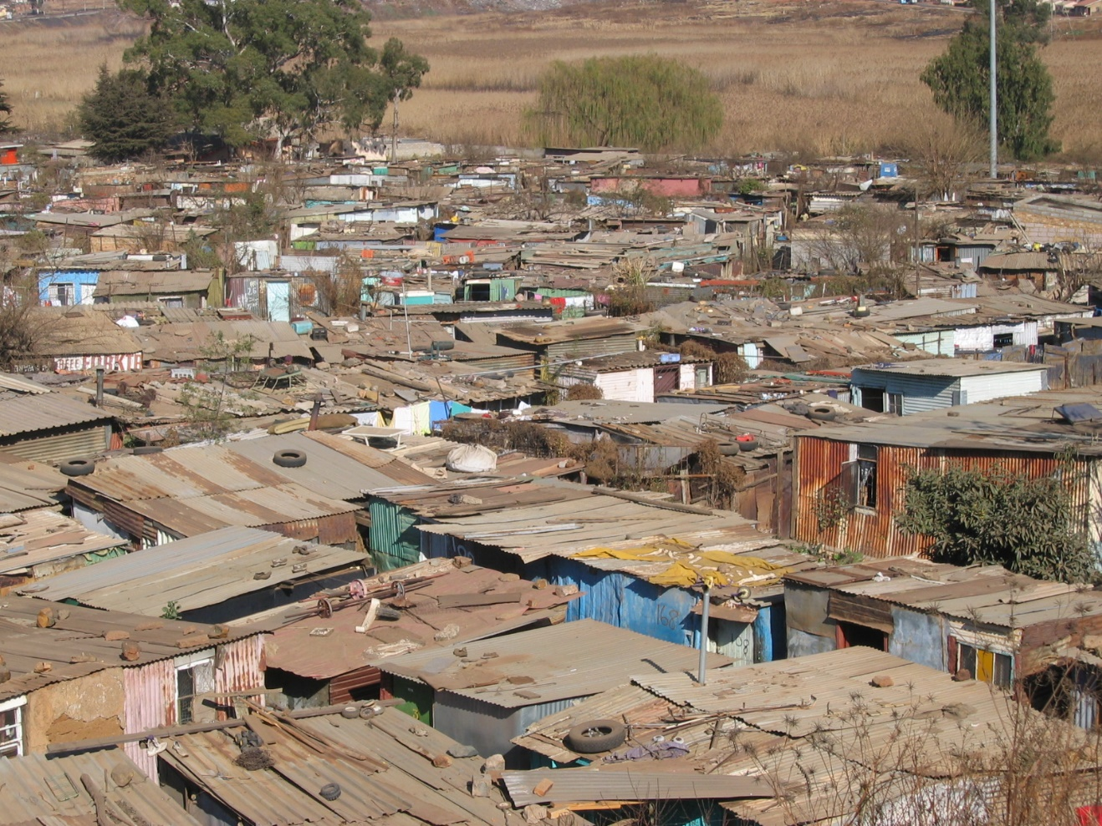
© 2014 Brain Wrinkles

Slide 9
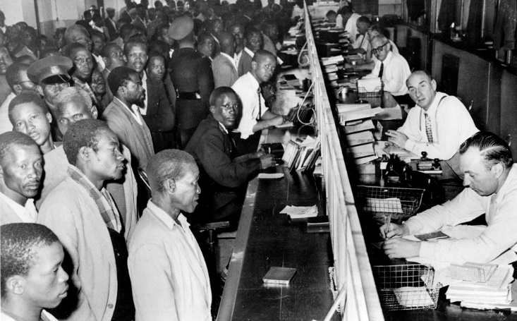
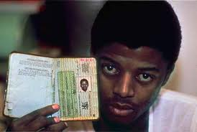
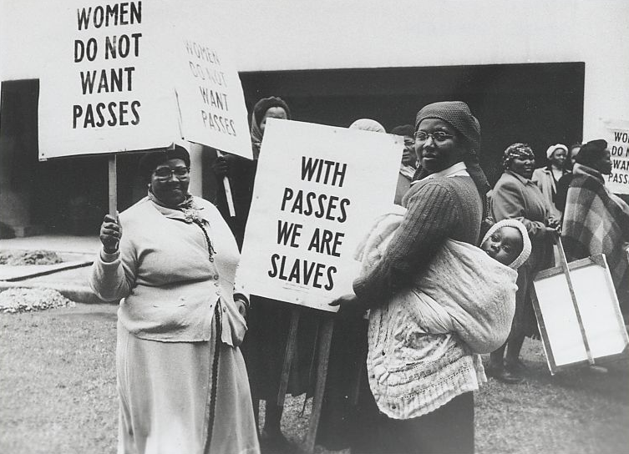
Black South Africans line up at the counter of a government office to get their new passbooks in Johannesburg, South Africa, April 7, 1960.
© 2014 Brain Wrinkles

Slide 10
A.N.C. and Nelson Mandela
In the 1950s, the African National Congress, or ANC, began to actively fight apartheid.
The goal of the ANC was to increase rights of native Africans
Eventually, the ANC was declared illegal by the South African government and members were often arrested.
Nelson Mandela was a leading member
Believed in non-violent protests
Mandela was accused of plotting against the only white government
He was arrested at the age of 46 and was sent to life in prison at Robben Island where he was forced to do hard labor
Only allowed one visitor every 6 months

Slide 11
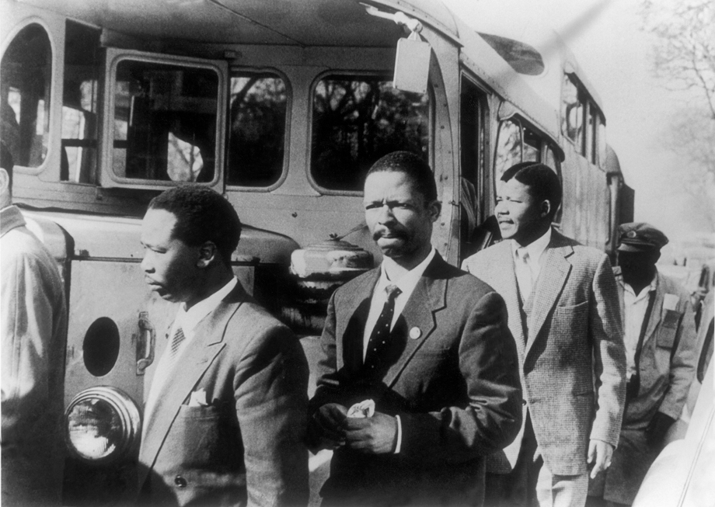
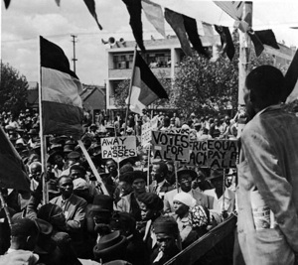
ANC Members (Nelson Mandela, second from right)
© 2014 Brain Wrinkles

Slide 12
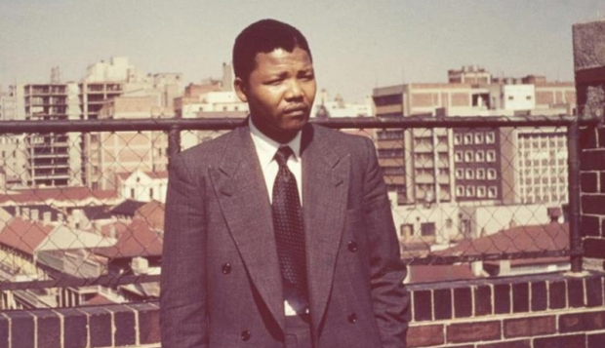
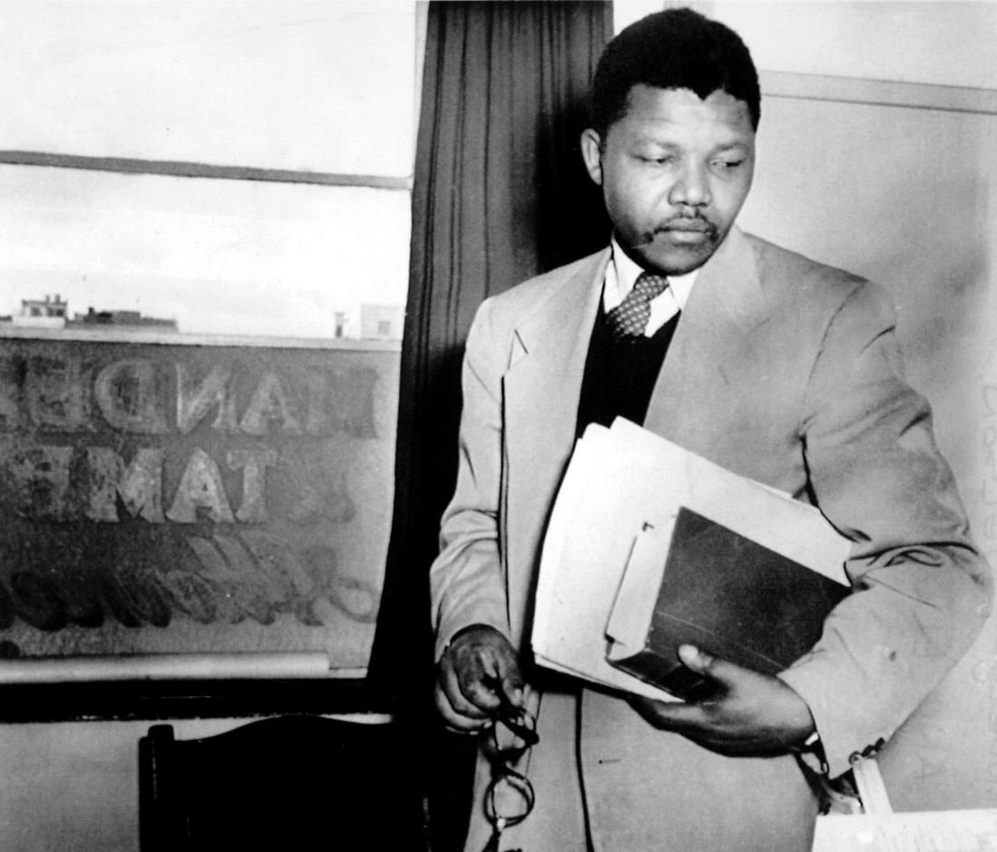
© 2014 Brain Wrinkles

Slide 13
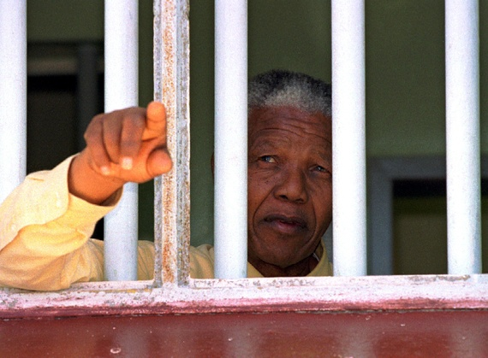
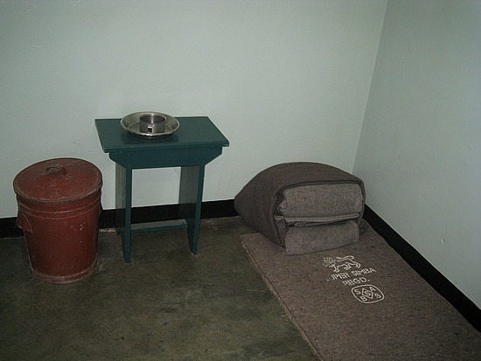
© 2014 Brain Wrinkles

Slide 14
F.W. de Klerk
In 1989, F.W. de Klerk elected president and worked to dismantle the apartheid system
Almost immediately, de Klerk did away with the ban on the ANC
He released Mandela from prison in 1990
Mandela served a total of 27 years
F.W. de Klerk worked with Mandela to end apartheid.
In 1993, de Klerk and Mandela shared the Nobel Peace Prize for moving the country peacefully to a nonracial democracy.
In 1994 apartheid officially ended and South Africa held its first election open to all races.
Nelson Mandela was elected the first black president of South Africa.

Slide 15
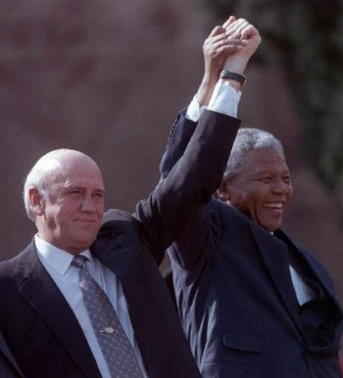
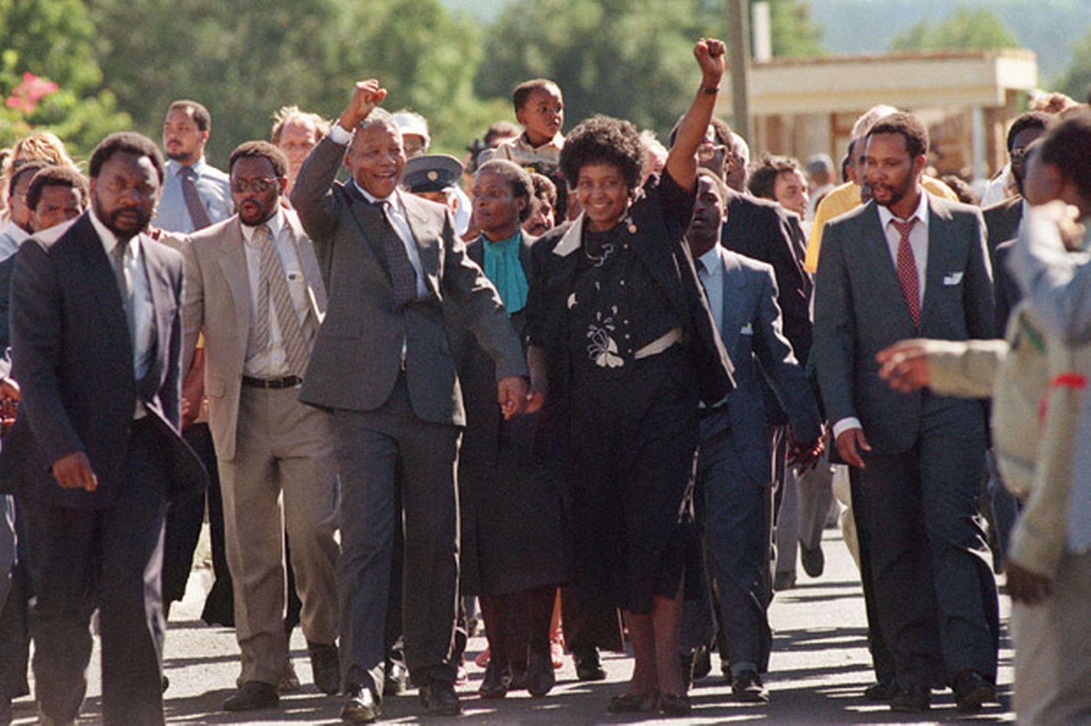
De Klerk and Mandela
Mandela Released from Prison
© 2014 Brain Wrinkles

Slide 16
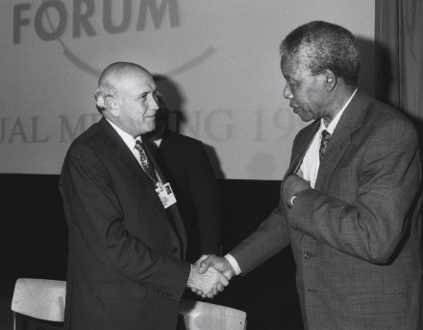
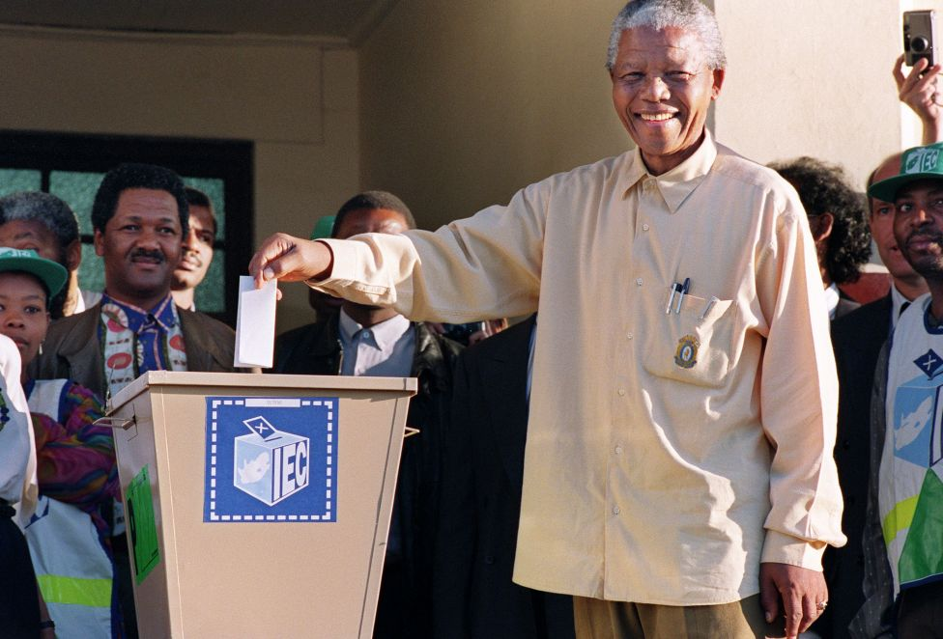
De Klerk and Mandela, 1992
Mandela Voting, 1994

Slide 17
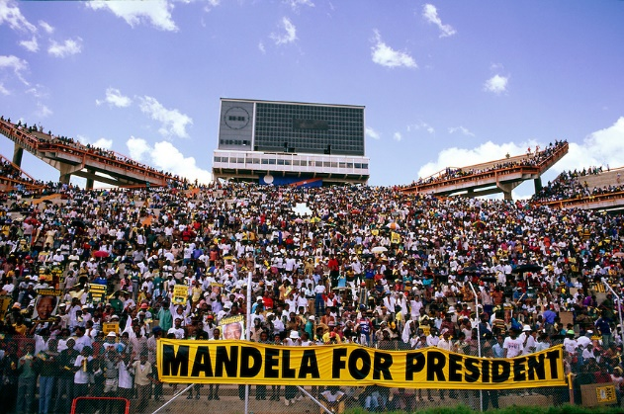
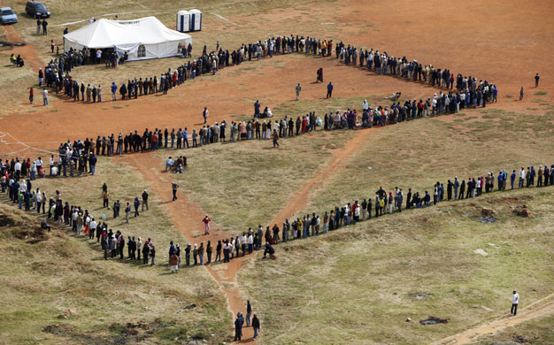
Waiting in line to vote, 1994
© 2014 Brain Wrinkles

Slide 18
Today…
Despite having a stable democratic government and the strongest economy in Africa, South Africa still has major issues.
There is still economic inequality and poverty throughout the country.
Most of the wealth is concentrated in predominately white urban areas.
The rural areas where blacks are predominate are still terribly poor.

Slide 19
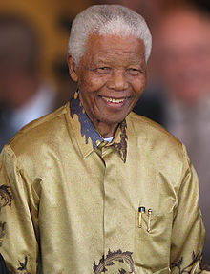
Nelson Mandela
July 18, 1918 – December 5, 2013
© 2014 Brain Wrinkles

